Slide 1
ADVANCED SECURITY TIPS Windows
Gary Paff
Notes:
Present Threats and Tips to Protect against them
Some areas I’ll indicate how you can execute Protection but some I won’t because of levels of expertise.
Should take about 40 minutes to an hour. After that questions
Some of what’s presented is Basic and you may already be aware.

Slide 2
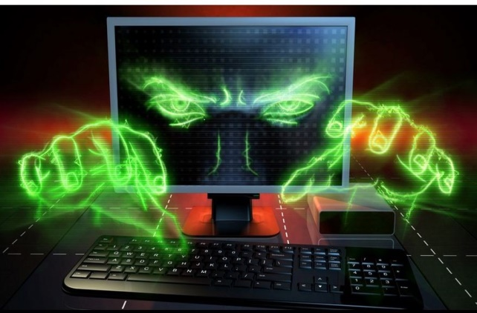
IMPORTANT THINGS TO KNOW
HACKERS ARE OUT THERE
NO SYSTEM CAN BE 100% SECURED
USE BASIC PROTECTION IS A MINIMUM
OPERATING SAFER CAN BETTER PROTECT YOU
Notes:
Hackers are constantly trying to invade your system
No Anti Virus software will catch everything
You can take steps to minimize risk

Slide 3
AREAS NEEDING PROTECTION
COMPUTER
PCs & MACS
CELLPHONES
TABLETS
WIRELESS ROUTER
USING THE INTERNET
Notes:
Computer
Router
Web Browsing

Slide 4
BASIC PROTECTION
Computer Settings
Anti-Virus
Firewalls
Malware Blockers
Passwords
Notes:
Most average persons use BASIC PROTECTION.
Anti Virus
Firewalls
Malware Blockers
Windows 7 thru11 has Firewall & Anti-Virus built in. Previous versions use 3rd party software.

Slide 5
ANTI-VIRUS
MUST have an Anti Virus program
MUST keep it updated. Set for Auto Update
Protected ONLY from date indicated
DON’T RUN COMPUTER WITHOUT IT
Don’t open attachments you can’t identify
USE ONLY ONE AV
Notes:
VIRUS CAN SNEAK IN VIA EMAILS OR WBSITES
AV IDENTIFIES, WARNS AND BLOCKS SOFTWARE THAT IT KNOWS OR SUSPECTS TO BE A VIRUS
COMPANIES UPDATE AV DAILY WITH NEWLY IDENTIFIED VIRUSES
SOME AV ALSO USE ALGORITHMS AS WELL AS DAILY UPDATE
CAN ONLY USE ONE AT A TIME

Slide 6
SOME POPULAR WIN & MAC
Total https://www.totslav.com
Avast https://www.avast.com/en
Avira https://www.avira.com
Bitdefender https://www.bitdefender.com
All have Free versions that are good
Notes:
Most Popular FREE AVs

Slide 7
OPERATING SAFER
Modify Windows Settings
Use Stronger Passwords
Two Step Authentication
Safe Email Accounts
Disable vulnerable software
Modify internet access settings
Using VPNs

Slide 8
ACCOUNT TYPE
Windows REQUIRES one Administrator
Default will always be “Administrator”
Set up a second User as “Standard”.
Sign in as “Standard” user
Can't change advanced settings.
Can’t install programs.
Requires Administrator password.
Use the Administrator account ONLY when required
Notes:
MUST HAVE AN ADMINISTRATOR ACCOUNT TO MANAGE WINDOWS.
During install Windows defaults to this type
If hacked while on line, Hacker can control computer
Setup a “Standard” account and sign in with this account
Standard account can do almost anything that you can do with an administrator account.
Can’t do things that will effect other users
If tried, Message will asking for the ADMINISTRATORS PASSWORD

Slide 9
Change Account Type Go to Control Panel and open “User Accounts “ Click Manage another Account then Add an Account
Notes:
Go into Control Panel and Click on “Users”
Navigate by “Manage another account” and “Add New User”
SET UP AS “STANDARD”

Slide 10
FIREWALL
Not all Firewalls are perfect
Win 7 thru 11 have a built in Firewall
Security Suites will replace it if installed
Routers have a built in Firewall
MAC Ios has also but must be activated
ZONE ALARM
https://www.zonealarm.com/software/free-firewall
Notes:
Windows Firewall usually is enough
MACS not automatically turned on
Recommend you use a Firewall in Computer even if you have a router
Router Firewall blocks only “IN”
Most Computer Software blocks IN & OUT

Slide 11
PORTS
Some software require open ports for access
Could make you vulnerable
Unless required, all should be closed
You can Test for open ports
https://www.grc.com/x/ne.dll?bh0bkyd2

Slide 12
PORT TEST https://www.grc.com/x/ne.dll?bh0bkyd2
Notes:
Link will take you directly to the Test
Click Proceed
Click All Service Ports
Test will start automatically

Slide 13
SUMMARY
Notes:
Let it run until “Summary”
All Green means Firewall is working
Open port shows as RED

Slide 14
PASSWORDS

Slide 15
Strength of the password is your BEST defense
Strength is determined by combination of
character and length
https://howsecureismypassword.net/
AVOID | TIPS
• Your First Name • Your Last Name • Your Birth Date • Your Pet's Name • Your Street Name • Your High School • Your Username | • Use Long Passwords • Use both letters and numbers • Use characters: * or ^ • Frequently change passwords • Do not write passwords down • Don't choose 'save password' when using public computers
Notes:
Strength of the password is your BEST defense
Strength is determined by combination of character and length
Link to check strength

Slide 16
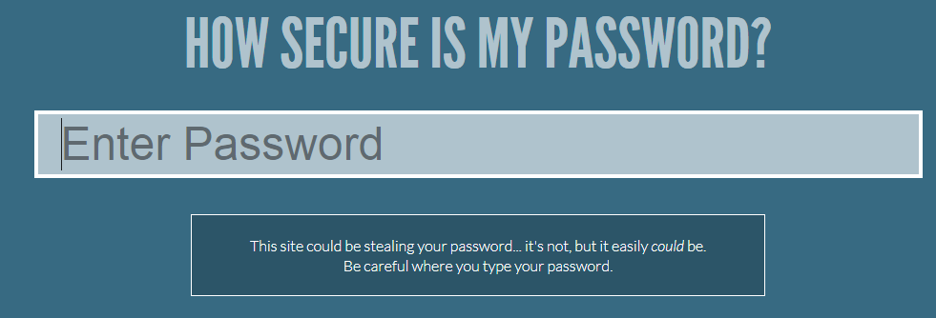
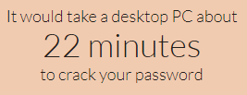
goodheart
goodHeart
goodHeart&
$goodHeart&
https://howsecureismypassword.net
Notes:
Basic 8 letters 22 minutes
Same with one Cap 8 Days
One Cap plus Character 14 years
Added one more character 927 Years

Slide 17
TWO STEP AUTHENTICATION
Some sites allow or Require Two Step Authorization
Google, Facebook, Microsoft, Apple
Banks, Brokerages etc.
USE IT IF AVAILABLE
How does two-factor authentication work?
You need to provide two pieces of information to get into your account.
The first is your password.
The second is another code which may be
sent by phone or text
Notes:
Second Authenticator
Can be Second User and Password
Can be Numonic Figure or sent via Text or Phone

Slide 18
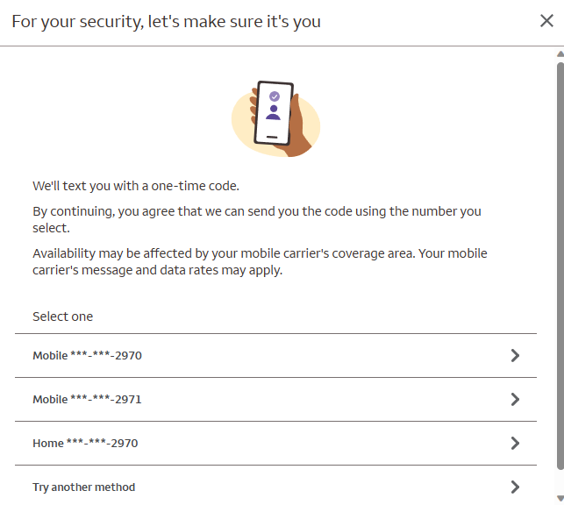
EXAMPLE
Notes:
In this case I use same ID but Different passwords

Slide 19
CODE ENTRY

Slide 20
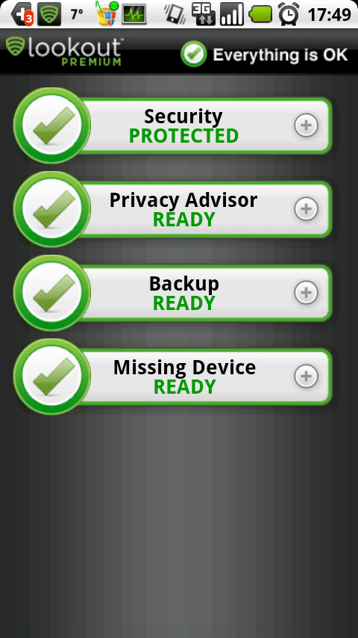
SMARTPHONES & TABLETS
Several of listed AVs are compatible
LOOKOUT for Apple & Android
https://www.lookout.com/life
Notes:
ALSO NEEDS PROTECTION

Slide 21
ROUTER SECURITY
Most Routers come with set security
Change the default name of your router.
Change your router's pre-set password
Verify Encryption
Two Types of encryption
TKIP & AES. Most new Routers Default to AES
Router and Computer must be set to same type
Two best Methods of encryption to use:
WPA2-PSK or WPA3-SAE.
Notes:
WPA3-SAE newest and most secure
WPA = WI-FI Protective Access, PSK = Phase Shift Keying
WEP Basic DON’T USE IF YOU HAVE ALTERNATIVE Older Verizon routers preset to WEP
Types; ……….TKIP (Temporal Key Integrity Protocol
or
AES (Advanced Encryption Standard (uses different methodology to encrypt)

Slide 22
DISPOSABLE EMAIL
An email account when you don’t want to give out your primary email.
Valid when used
Can be set up with expiration date
Infected attachments (virus/malware) contained
Less “Junk” mail in personal mail
Shouldn’t be used for Finance or sites with Sensitive information
Two with different features
https://www.temporarymail.com
https://www.emailondeck.com
Notes:
May or may not require Passwords

Slide 23
Insecure and Awful Software JAVA
Used to develop Software
Used by Hackers to infiltrate
Not needed 99.5% of the time by users
At a Minimum, KEEP IT CURRENT
Should be Disabled or Uninstalled
Disable in Browsers Add Ons
Uninstall in Control Panel
Notes:
Some Software requires Java to run
Can install at that time

Slide 24
ActiveX
Some websites need ActiveX to view it.
Can be compromised
Browsers asks if you want to install the ActiveX.
If ActiveX is not essential, avoid installing

Slide 25
WEB SECURITY
Best Defense
Don’t open suspect sites or email
Don’t use real information
Wrong Answer to question
Remember the false information
Use an anonymous Search Engine
Duckduckgo.com
Google not anonymous
Use encrypted connection when possible
Notes:
Answer Security questions with different answers. Could use “Gettysburg Address”
Change Date of Birth
Duckduckgo.com. Does not track user. Runs as fast as Google. Great for basic searches ie: Maps, Movie times, Restaurants etc

Slide 26
MALWARE
Unwanted Software
Mostly Worms, Trojans, Adware , Virus
Most are caught with AV software but not all
Need Anti-malware software to find & remove
Malwarebytes https://www.malwarebytes.com
Superantispyware: http://www.superantispyware.com
Notes:
Short for “Malicious Software
Virus attaches itself to a file. File needs to be open to spread
Worms Replicates itself to spread. Similar to Virus but will spread by itself
Can be by just visit to site
Trojan Worst type. Appear to legit software but can disrupt computer operation, wipe out discs
Adware or Ransom Ware. Holds computer hostage
Free Versions Run once a week MINIMUM

Slide 27
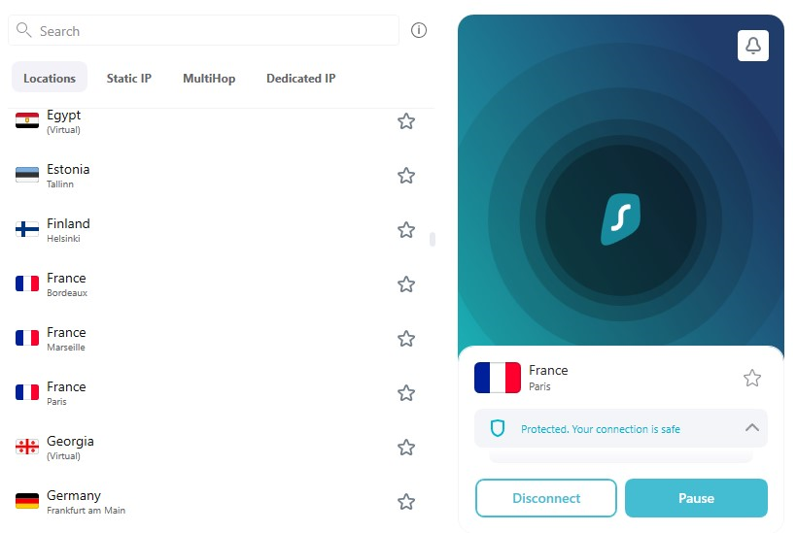
VPN (Virtual Personal Network)
Notes:
Has Pros and Cons
Acts like an additional Firewall
Allows user to use an IP address in another location
Makes REAL location “Stealth”
Some sites may not load through a VPN
Would require user to either Pause or disconnect

Slide 28
CONCLUSION
Use available Security Software
Run Security software as needed (once a week)
Stay Alert

